Slide 1
Traffic Analysis System
Update: 09/04/2021

Slide 2
Traffic Analysis System
Video Downloader
Object Detection System (YOLOv4)
DB Uploader
Object Tracking System (Norfair)
Archiver
Data Analysis Modules
Vehicle types
Traffic lanes
Speed
Density, etc.

Slide 3


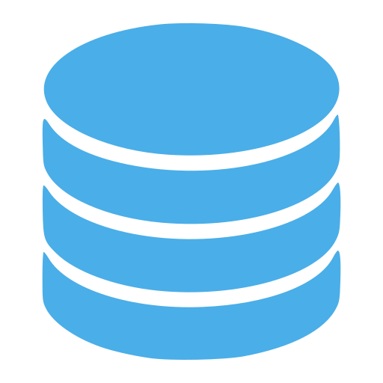
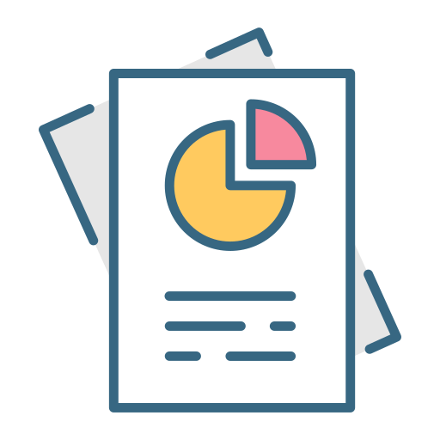
Traffic Analysis System
Video
Downloader
Object Detection
(YOLOv4)
Object Tracking
(Norfair)
CCTV NVR
Path: incoming
*.avi
Path: queue
*.npz, *.avi
DB
Uploader
Database
Path: archive
*.npz, *.avi
Archiver
Path: done
*.npz, *.avi
Data Analysis
Modules
Reports

Slide 4

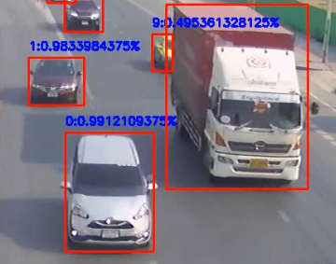
Object Detection System (YOLOv4)
Table: detect
Object Detection
(YOLOv4)
Column | Data
* cctv_id | 0
* cctv_date | 2021-04-09
* frame_no | 297
* object_no | 1
class | 0
score | 0.51233
x1 | 226
y1 | 482
x2 | 123
y2 | 247
CCTV Video
File: npz

Slide 5
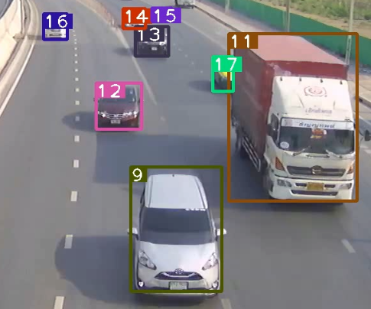
Object Tracking System (Norfair)
Table: track
Table: detect
Column | Data
* cctv_id | 0
* cctv_date | 2021-04-09
* frame_no | 297
* object_id | 2
class | 0
score | 0.51233
x1 | 226
y1 | 482
x2 | 123
y2 | 247
live | True
Object Tracking
(Norfair)
Table: track
Database

Slide 6
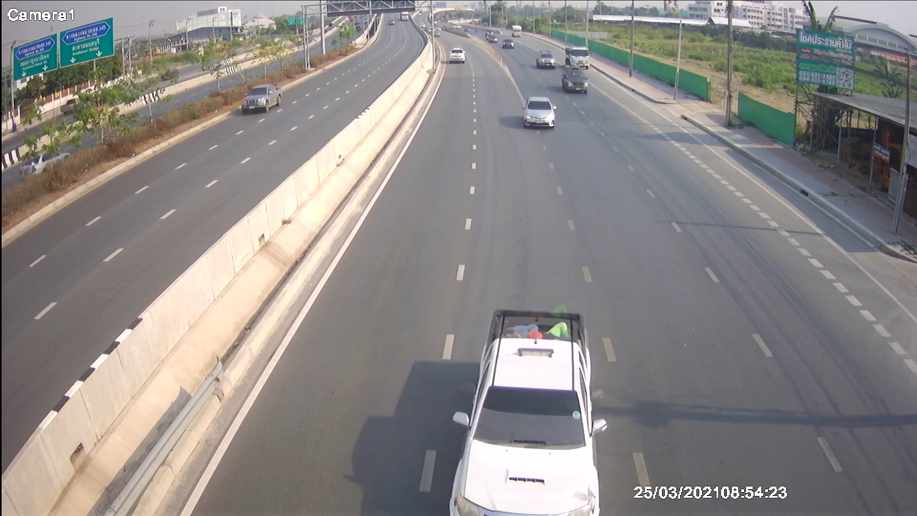
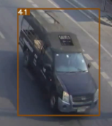
Object Tracking System
Accurate Class Identification
Table: track (filtered by Y position)
Frame | Class | Score | Pos (Y)
608 | 2 | 0.51 | 353
609 | 2 | 0.50 | 360
610 | 7 | 0.91 | 368
611 | 7 | 0.91 | 373
612 | 7 | 0.70 | 385
642 | 7 | 0.92 | 974
643 | 7 | 0.92 | 997
Most Accurate Detection Area
Table: object (raw score)
Table: object (raw scores)
Class | Total Score
2 (car) | 1.01
7 (truck) | 28.76

Slide 7
Data Analysis Modules
Data Analysis
Modules
Data Analysis
Modules
Reports
Vehicle types
Traffic lanes
Speed
Density, etc.
Database
Reports

Slide 8
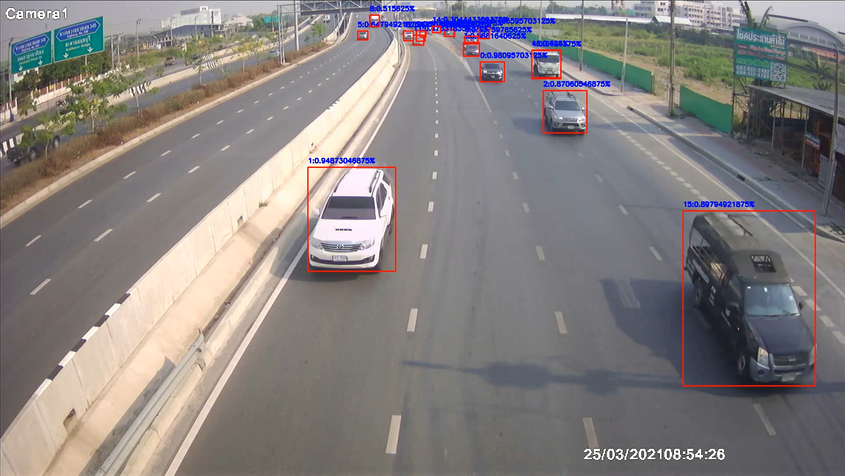
Module: Detection Visualization
mod_viz_detect.py
DB: detect
Bounding box: (x1, y1)-(x2, y2)
Class: class
Confidence: score

Slide 9
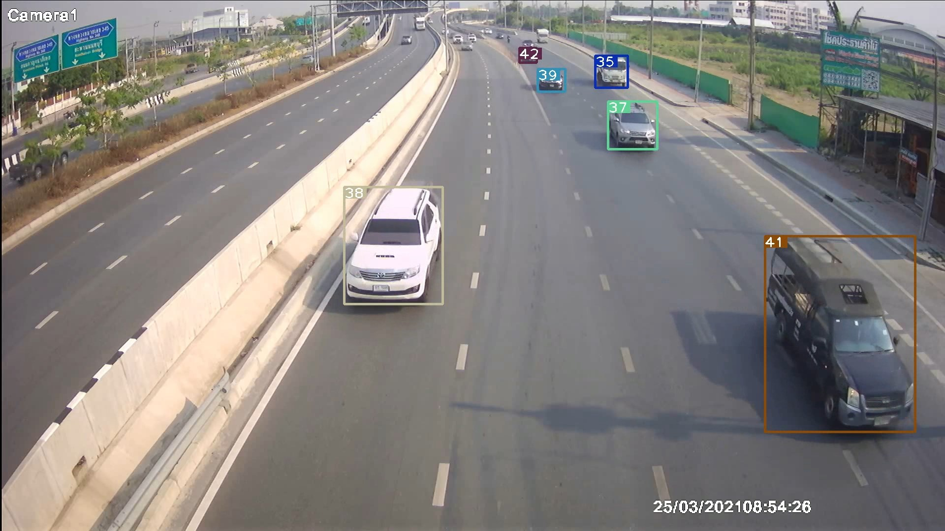
Module: Tracking Visualization
mod_viz_track.py
DB Table: track
ID: object_id
Bounding box: (x1, y1)-(x2, y2)

Slide 10
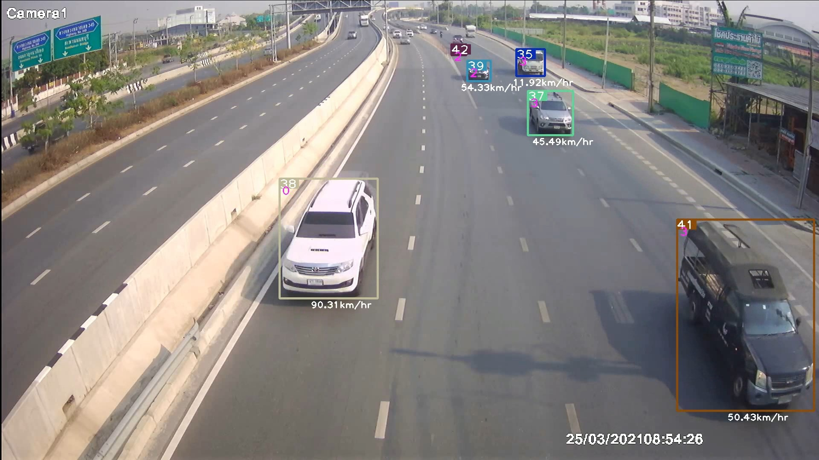
Module: Speed Visualization
mod_viz_speed.py
DB Table: track
ID: object_id
Bounding box: (x1, y1)-(x2, y2)

Slide 11
To-do List
DB: Status, Logs and Monitoring
DB: TimescaleDB
Download: Video Downloader - Method
Detection: Custom trained YOLOv4-Tiny model
Tracking: Improve Norfair distance function
Modules: More Reports and Modules
Archiver: Backup and Archive plan
SYS: Scalable multiple instances
SYS: Full loop testing
SYS: (Almost) Real-time processing from RTSP

